Slide 1






DIGITAL PORTFOLIO
STUDENT NAME : I.AYISHA
REGISTER NUMBER:24134131802522004
NMID:C5CF6CCFF4D243ABC45432D15A699FD1/
asanm41341324214004
DEPARTMENT: BSC.(C.S)-II
COLLEGE NAME: DEEN COLLEGE OF ARTS AND SCIENCE

Slide 2

STUDENT'S DIGITAL PORTFOLIO

Slide 3
AGENTA
● Problem Statement
● Project Overview
● End users
● Tools and Technologies
● Portfolio design and Layout
● Features and Functionality
● Results and Screenshots
● Conclusion
● Github Link

Slide 4
PROBLEM STATEMENT
The Traditional resume often fails to fully capture a student's skills and projectwork,making it difficult for them to stand out employers and academic institutions

Slide 5
PROJECT OVERVIEW
To Create an interactive Digital Portfolio Website that allow a student's to professionally showcase their academic projects, technical skills and personal achievements in a visually appealing and organised manner

Slide 6
WHO ARE THE END USERS
Students:
The creators of the portfolio,who want the professional to prevent their works
Recruiters/Hiring Manager:
Professionals who need to quickly accesses a candidate's abilities and project abilities
Academic Institutions:
Admission officers evaluating applicants for graduation programs

Slide 7
TOOLS AND TECHNIQUES
● HTML:
The foundational language for structuring the portfolio contents, including headings,paragraph and contents.
● CSS:
Used for styling the website to control its layout,fonts,colours and responsiveness
●JavaScript :
Adds interactivity such as smooth scrolling for navigation, dynamic content loading,form validation
● Git&Github:
For version controlling,allowing the students to manage project code and elaborate effectively
● Deployment:
The portfolio can be hosted for the sources like Github or Netlify,making it accessible to anyone with an Internet connection

Slide 8
PORTFOLIO DESIGN AND LAYOUT
DESIGN
● Simple Colour Scheme:
The portfolio uses a limited colour palettes for a professional and clean look
● Visual Hierarchy:
Different font sizes and weights are used to guide the user's emphasis key information

Slide 9
LAYOUT
● Clean, minimalist and responsive:
The overall layout is uncluttered and adopted well to the different screen sizes
● Header:
The top of the page includes the student's name,a brief tagline and a navigation bar
● Dedicated Sections:
The content is organized into a separate sections each with its own clear heading like "About" and "skills"

Slide 10
FEATURES AND FUNCTIONALITY
FEATURES
● Project Showcase:
A section for students to display their works including title,description, links to the projects and its code
● Skill Highlights:
A simple and updatable lists of technical skills
● Professional contact informations:
A section with contact details and links to professional profiles like LinkedIn, Github

Slide 11
FUNCTIONALITY
● Interactive Navigation:
The Navigation provides a smooth scrolling animation when links are clicked,instead of an abrupt jump
●Responsiveness:
The layout adjust to a different screen sizes,ensuring a good user experience on both desktop and mobile devices

Slide 12
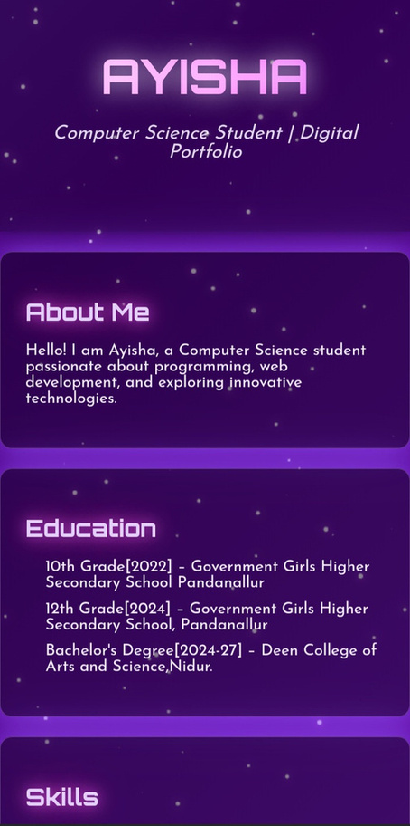
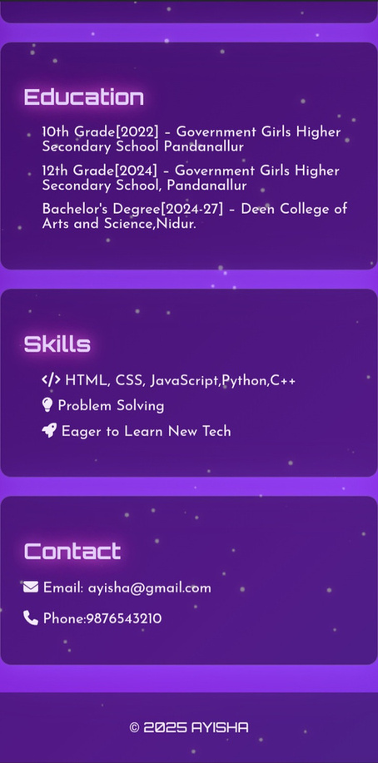
RESULTS AND SCREENSHOTS

Slide 13
CONCLUSION
● Highlights of projects:
Ayisha's projects,a student management system and a code editor,show her practical skills in both front-end and back-end development
● Benefits to soceity:
Her project offers a real world benefits from improving school administration to helping programmers work more efficiently
● Final Summary:
This portfolio effectively proves Ayisha's potential as a software developer showcasing her foundational knowledge and applied project skills

Slide 14
GITHUB LINK
https://github.com/dccs24ayishaa-hub/Ayisha--TNSDC-FWD-DP.git

Slide 15
THANK
YOU

